Slide 1
Learnable Spatial propagation Networks
Sifei Liu, June, 2019
Notes:
Good morning and welcome to the tutorial of graph-structured networks.
I am Sifei Liu from NVIDIA, learning and perception research.
Today I am going to talk about Spatial propagation networks, a new structure modeling the relations between visual elements.

Slide 2
Pairwise relations
Non-Local
Spatial Propagation
Notes:
Our goal in the work is: to learn the pairwise relations between visual elements.
One of the most typical model of pairwise learning is non-local module, which will be introduced soon by Xiaolong.
Before he talks about it, I would like to use non-local network as an example to show the concept of pairwise model.
The non-local network is a typical module that connect each pixel (click) to all the other pixels in an image, where dense relations is explicitly encoded.
Suppose we have the same image, the spatial propagation networks encodes the relationships in a totally different manner – it utilizes propagation structure, where information can be passed from the first visual element, to the last one.
One obvious advantage can be recognized: without lose of long-term propagation, each pixel in propagation network only have 4 connects, which means we have much fewer edges or parameters to learn or to compute.

Slide 3
Structures are important!
Non-local
Spatial propagation
Notes:
I would ask the question again: why the relation between pixels is so important ? From my understanding, this is because objects in the real world is highly structured.
For example, when we have the hand, the pixels belonging to the hand group together with a particular structure, as well as an angle, so that we can percept it as a very familiar hand gesture.
However, it is hard for either convolution or non-local to understand it.
For example, non-local or bilateral kernel models the distance of two green patches in this manner – by considering their euid distance, from the spatial and the appearance.
It ignores the underline structure.
In contrast, the spatial propagation network is able to scan all the possible local edges, and finally infers the paths that adhere the the object itself, and thus be able to understand the internal structure.
We call it as structure preservation, which is particularly important for low level and mid level applications, which require to produce a map or an image containing much details.

Slide 4
Learnable Spatial Propagation Network
Outlines
1D SPN
2D SPN
Unstructured SPN
Notes:
In this talk I will introduce a series of our work for this topic.
The line of research started from the 1D propagation, in 2016, and then we extend it to 2D propagation to make the module more powerful.
Recently, we also extend it to unstructured data, such as super-pixels and point clouds.

Slide 5
Learnable Spatial Propagation Network
1D SPN
…
Notes:
We started to conduct the 1D propagation by simplify an image into individual rows and columns.
Then we have a lot of 1D signal, where we can utilize the tools in the traditional signal processing.

Slide 6
Learnable Spatial Propagation Network
2D SPN
…
Notes:
After that, we proposed the 2D propagation network to make pixels more dense associated with each other.

Slide 7
Learnable Spatial Propagation Network
Unstructured SPN
Notes:
And finally, we have the unstructured SPN, which is able to get rid of a rigid grid.

Slide 8
Learning Recursive Filters for Low-Level Vision via a Hybrid Neural Network
Sifei Liu, Jinshan Pan, Ming-Hsuan Yang
ECCV 2016
Notes:
We will start from the 1D propagation, a general framework where we apply it to low-level vision problems.

Slide 9
problem formulation
filter
bilateral filter
guided filter
…
filter coefficients
Notes:
Suppose we conduct edge preserving filtering, traditionally we will use bilateral/guided filter or others in between.
However, some of the filter, for example, computed via matrix decomposing, is time consuming.
So we can use a network to learn them so that we can produce any effect in constant time.
What we do is to utilize a linear digital filter, while using a deep neural network to learn it coefficients in the data driven manner.

Slide 10
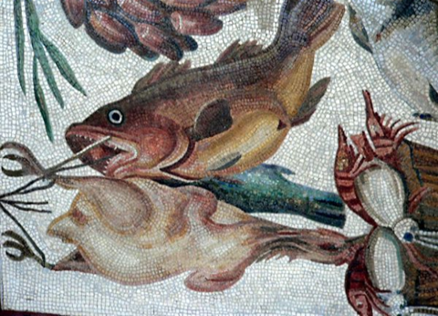
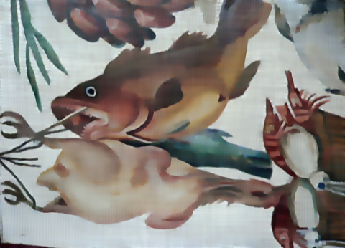
Low-Level Vision Problems
Edge-preserving filter
Notes:
The model can be applied to a variety of low-level vision tasks, including edge-preserving filtering

Slide 11
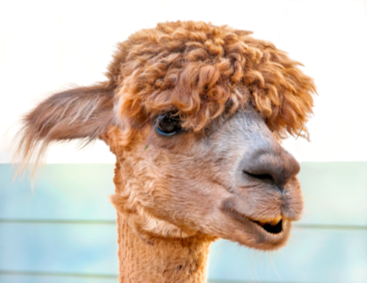
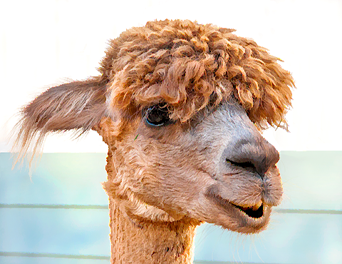
Low-Level Vision Problems
Enhancement filter
Notes:
image Enhancement

Slide 12
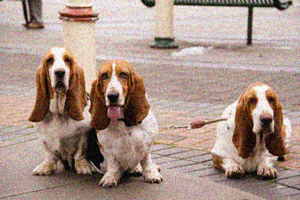

Low-Level Vision Problems
Image denoising
Notes:
image denoising

Slide 13
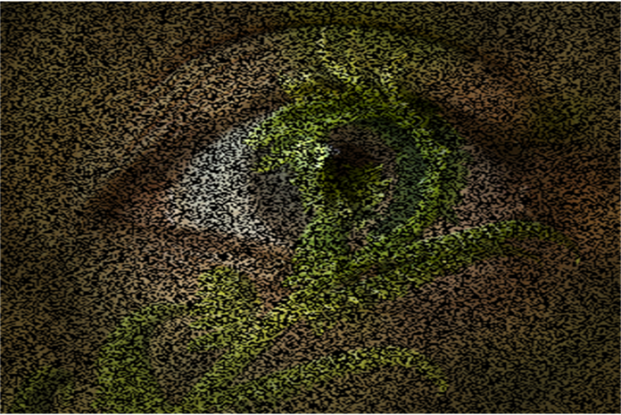
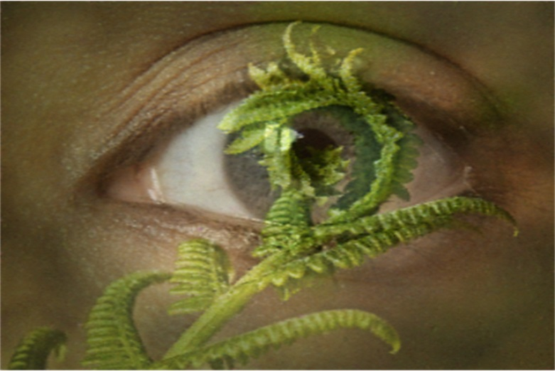
Low-Level Vision Problems
Image inpainting
Notes:
inpainting

Slide 14
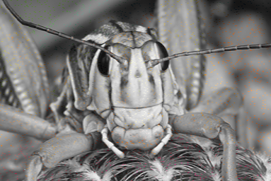
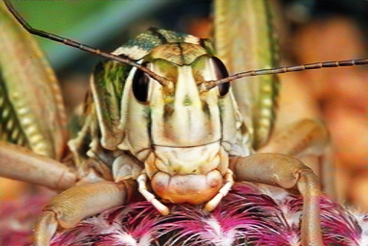
Low-Level Vision Problems
Color interpolation
Notes:
and color interpolation

Slide 15


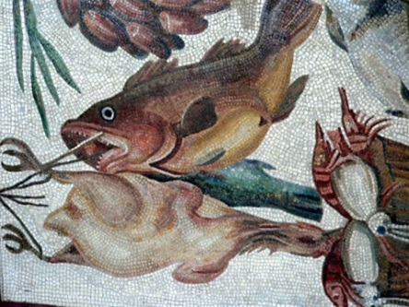

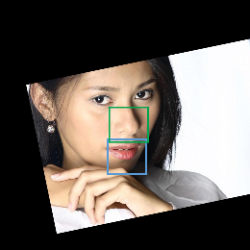
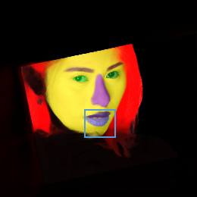
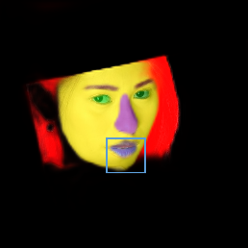
Low-Level Vision Problems
Notes:
We also conducted the experiment for segmentation, where the model can significantly refine the probability map.

Slide 16
Learnable Digital filter?
filter
filter coefficients
FIR: CONV
Easy to estimate the coefficients
Short-term
IIR: Recursive
Hard to estimate the coefficients
Long-term
Notes:
Since we simplify an image to a group of 1D signals, what we do is to make the digital filter a learnable module, and embed it into a neural network.
There are two typical digital filters: FIR and IIR filters.
The FIR filter is also called convolutional filter. similar to the convolutional layer, it always has a limited kernel size to only account for short-term filtering. but it is more frequently used since the coefficients are easy to design.
The IIR filter is called recursive filter, it has a propagation structure similar to RNN, but with linear operations. The IIR filter has fewer coefficients and infinite propagation range, however it is less used due to the difficutly of coefficient estimation.
In this work, (click) we utilize the IIR structure, and directly learn its coefficients with the powerful deep neural networks.

Slide 17
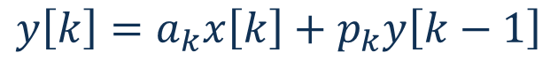
IIR: recursive filter
Small number of parameters
Still long-range
Notes:
Here we briefly introduce the formulation.
The IIR filter contains a unary term, and a recursive term. (click) Each pixel has only two coefficients/edges combine the information from these two pixels.
The computation is still long-range because the recursive term can be unrolled to a global scope.

Slide 18
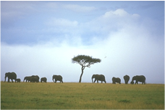
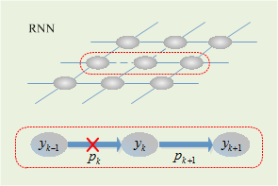
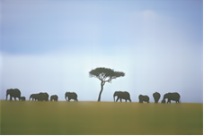
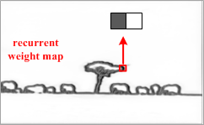

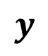
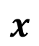
Learnable recursive filter
$$x$$
$$y$$
filter
✓
filtering
$$p$$
conv
pool
conv
pool
guidance of
the filter
CNN
Notes:
As a deep learning block, the IIR filter is a simple, linear 1D RNN that sequentially connects pixels.
The connections determines whether we should ``stop’’ the propagation, so that to preserve an edge pixel, or to ``open’’ it to smooth out the texture details.
In the task of edge preserving smoothing, the connection is associated with an ``edge map’’, where only in the edge regions, the coefficient p is close to zero.
There is a CNN as a guidance network to learn the edge map, which is connected to the IIR structure.

Slide 19
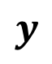
Learnable recursive filter
$$x$$
$$y$$
filter
✓
produced by:
RTV filter
shock filter
Photoshop
…
$$p$$
forward
backward
conv
pool
conv
pool
CNN
Notes:
(click) The whole framework is end2end trainable since the module is purely linear.
The ground truth can be from any filter or image processing effect, which is the only supervise we have for the task.

Slide 20
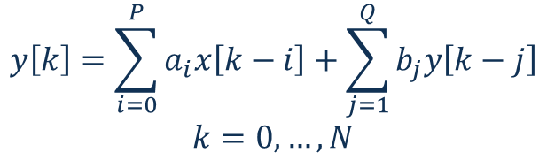
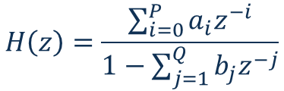

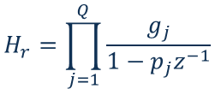
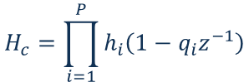
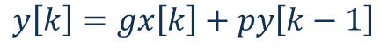

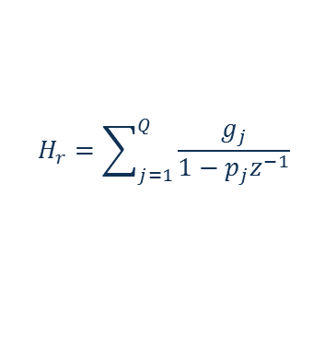
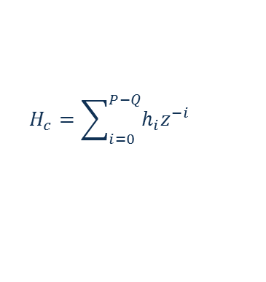
Module design – Signal processing
Spatial Domain
Z-domain
A general recursive filter
Z-transform
Cascade:
A recursive unit:
Parallel:
Notes:
The module design based on the transformations between spatial domain and Z-domain.
A general recursive filter can be transformed (click), and decomposed (click) into several first order recursive unit.
Each unit is a linear filter that can be equipped in the network as we show before.

Slide 21
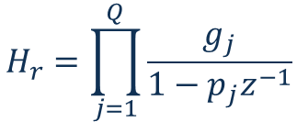
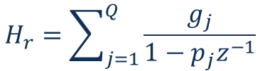
Module design – Signal processing
LRNN
A recursive unit:
Cascade:
LRNN
LRNN
LRNN
LRNN
LRNN
Parallel:
LRNN
Notes:
For filter with high-orders, we can construct them via either the cascade, or the parallel connections.
Empirically, filters with 2 units are powerful enough for complex image processing effects, since we have the end2end learnable coefficients.

Slide 22

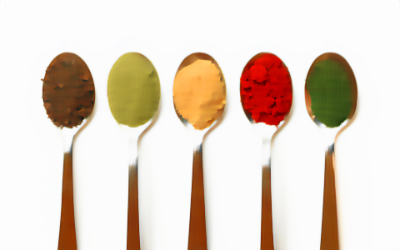
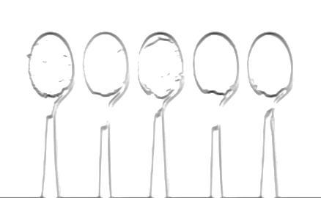
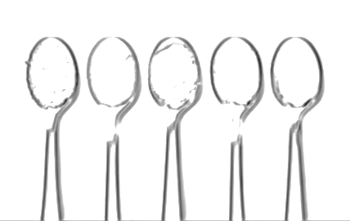
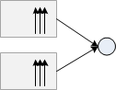



Module architecture
1D filters in 4 directions
$$x$$
$$p$$
Notes:
The linear RNN contains 4 1D propagation structure in 4 different directions, where 2 units can be combined in cascade or parallel manner.
The four independent hidden layers are then integrated with node-wise max-pooling.

Slide 23




Network architecture
Notes:
We also have a deep CNN, e.g., a U-net to output the weight maps, which guides the propagation.

Slide 24
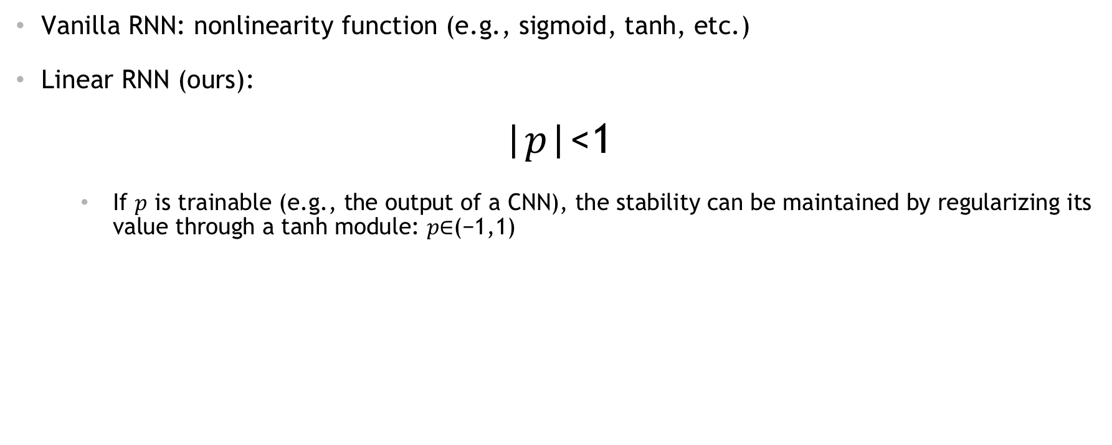
stability of the module
Vanilla RNN: nonlinearity function (e.g., sigmoid, tanh, etc.)
Linear RNN (ours):
|𝑝|<1
If $p$ is trainable (e.g., the output of a CNN), the stability can be maintained by regularizing its value through a tanh module: 𝑝∈(−1,1)
Notes:
Specifically, we need a stability condition since we are using a linear formulation, where there are no functions such as sigmoid to bound the value.
the condition is that the abs of coefficient P should be less than one.

Slide 25
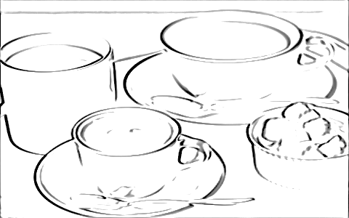


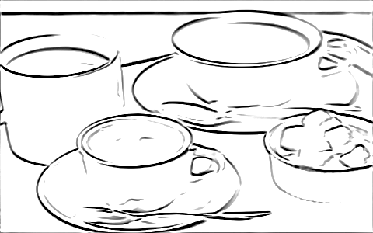
What we learn from the guidance net?
x-axis
y-axis
Notes:
Also we already showed before, the network can produce high-quality image processing results.
We can also visualize the outputs from CNN.
For all these edge-preserving methods, the CNN learns the guidance that very similar to the edge of the image, w.r.t. different directions.

Slide 26
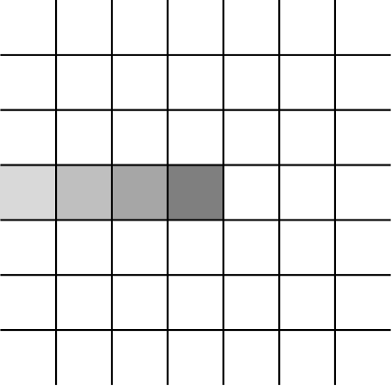
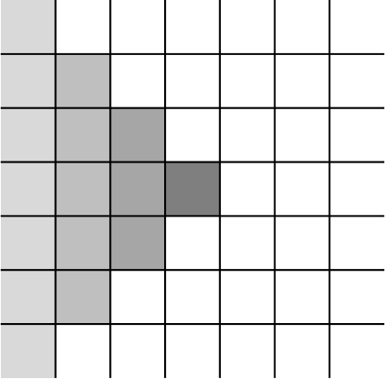
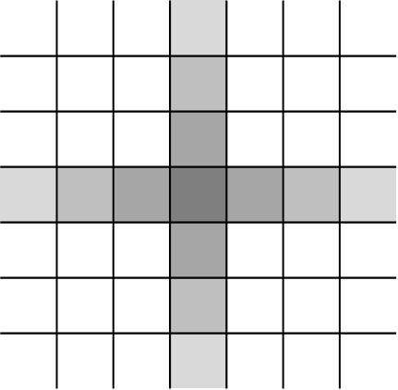
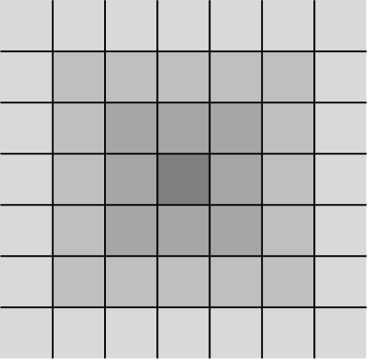
what is missing?
1D Propagation
2D Propagation
Recursive Filter
Linear diffusion
Notes:
However, is there anything missing in this module?
Let check the figure on the left. Even we draw the connections w.r.t 4 directions to the center, there is no way to propagate information between the two diagonal neighbors.
Indeed, it seems the propagation is super sparse and we missed a lot of information.
So in the following work, we propose the 2D propagation to address the problem, which is pretty easy to understand from this figure.
Since we no longer deal with 1D signals, our tool is ungraded from IIR filter to the linear diffusion model.

Slide 27
Learning Affinity via Spatial Propagation Networks
Sifei Liu, Shalini De Mello, Jinwei Gu, Guangyu Zhong, Ming-Hsuan Yang, Jan Kautz
NeurIPS 2017
Notes:
The 2D propagation is introduced in our work in Neurips 17.

Slide 28
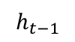
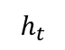
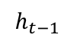
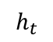
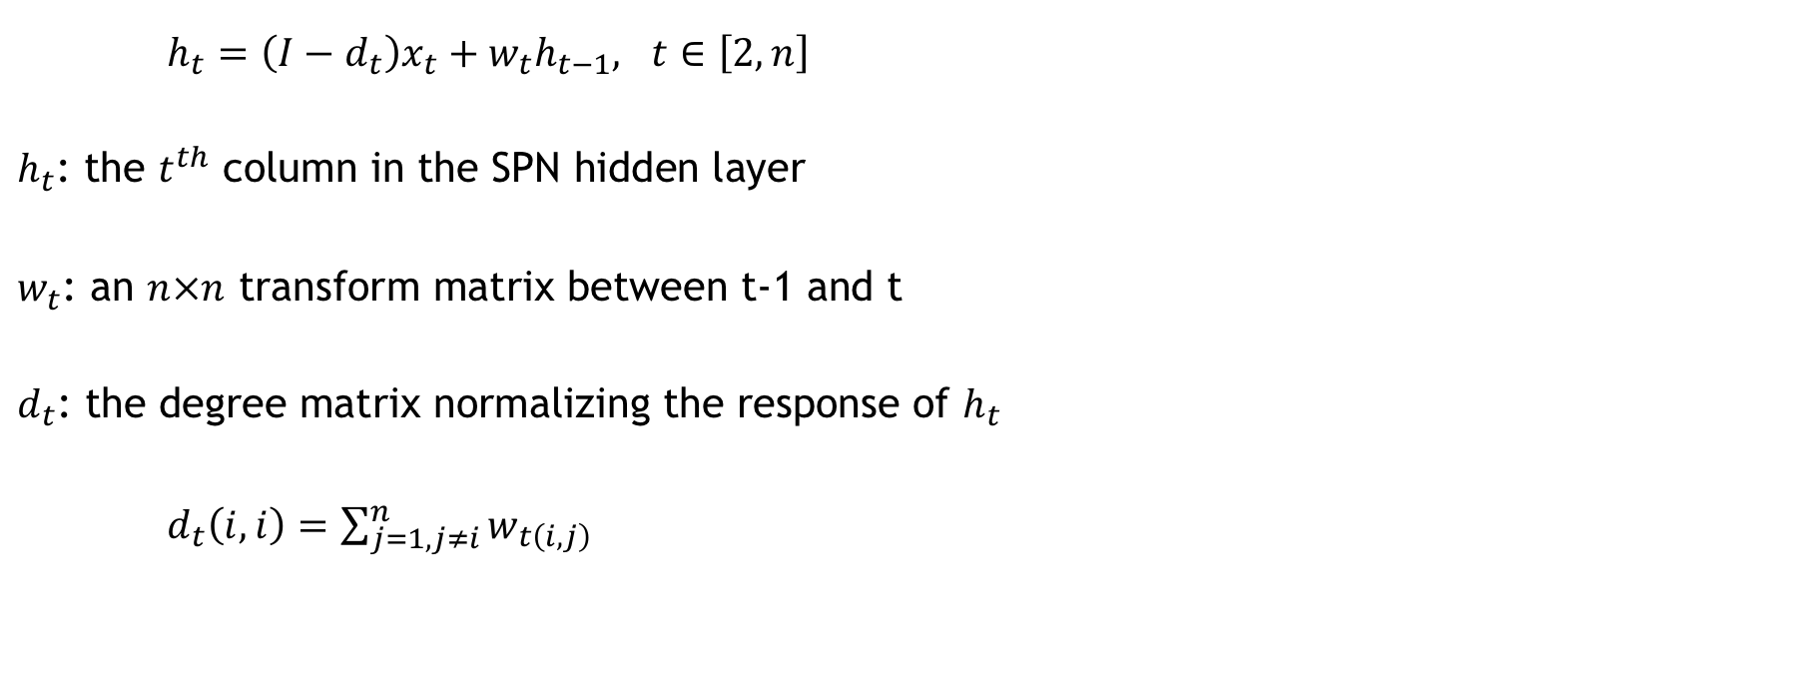
Spatial propagation network
Row/column-wise linear propagation
$h_{t}=\left(I−d_{t}\right)x_{t}+w_{t}h_{t−1}, t∈\left[2,n\right]$
$h_{t}$: the $t^{th}$ column in the SPN hidden layer
$w_{t}$: an $n×n$ transform matrix between t-1 and t
$d_{t}$: the degree matrix normalizing the response of $h_{t}$
$d_{t}\left(i,i\right)=\sum_{j=1,j≠i}^{n}{w_{t\left(i,j\right)}}$
left to right propagating
$$h_{t−1}$$
$$h_{t}$$
$$h_{t−1}$$
$$h_{t}$$
Notes:
Affinity matrix stores dense pairwise relations among pixels. So how the linear propagation associates with the concept of affinity matrix?
We can start from a general linear propagation method.
(click) Let’s take the left to right direction as an example, in the hidden layer, each column is a linear transformation from the previous one.
And here we use Wt to denote the transformation matrix, which is spatially variant.
A diagonal matrix d is used to normalize the response, each element of d is the summation of all the entries in the same row from w.
So (click) what exactly happens between ht-1 and ht is a linear multiplication, where we use one pixel in ht as an example.

Slide 29
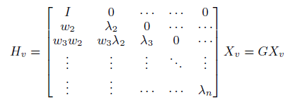
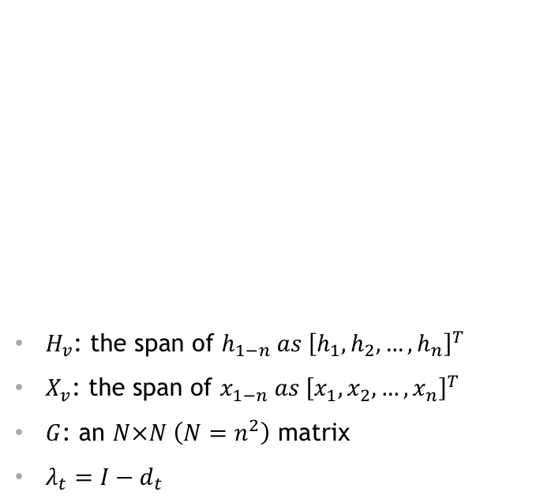
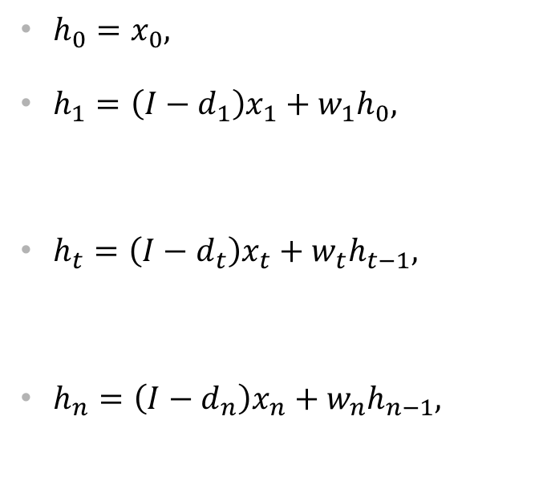
Spatial propagation network
Row/column-wise linear propagation
Affinity: the off-diagonal entities of G
$h_{0}=x_{0},$
$h_{1}=\left(I−d_{1}\right)x_{1}+w_{1}h_{0},$
$h_{t}=\left(I−d_{t}\right)x_{t}+w_{t}h_{t−1},$
$h_{n}=\left(I−d_{n}\right)x_{n}+w_{n}h_{n−1},$
$H_{v}$: the span of $h_{1−n} as {\left[h_{1},h_{2},…,h_{n}\right]}^{T}$
$X_{v}$: the span of $x_{1−n} as {\left[x_{1},x_{2},…,x_{n}\right]}^{T}$
$G$: an $N×N \left(N=n^{2}\right)$ matrix
$λ_{t}=I−d_{t}$
…
…
learnable affinity matrix = learn all $\left\{w_{1},w_{2},…,w_{n}\right\}$
Notes:
Since the propagation is recursive (click), we can expand it to a large matrix multiplication, which only contains the vectorized hidden layer H, and the input feature map X.
Between then is the large linear transformation matrix G.
The affinity matrix is the off-diagonal part of G, which is exactly constitute of all the individual sub-matrix w.
I.e., we already have this global, dense connections between pixels, (click) and all we need to learn is the local transform matrix w.

Slide 30
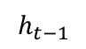


Spatial propagation network
Advantage: a compact representation
Parameters
Dense affinity (e.g., Non-local): $n^{2}×n^{2}$
Affinity in SPN (for all ($w_{t}$)): $n^{2}×n$
$$h_{t−1}$$
$$h_{t}$$
Notes:
One significant advantage is that our affinity matrix contains much fewer parameters than a standard dense global affinity matrix.
We reduce the pairwise terms for each pixel from the total number of pixels, to the number in a single row or column.
This is because our model only contains locally connected weights, where the long-term correlation is established by the propagation structure itself.

Slide 31









Reducing Connections
Three-way connection
Each pixel is connected to 3 adjacent pixels in the previous row/column
Tridiagonal-transform matrix $w_{t}$
$$h_{k.t}=\left(1−\sum_{k∈N}{p_{k,t}}\right)x_{k,t}+\sum_{k∈N}{p_{k,t}h_{k,t−1}}$$
where $N=3$
For each pixel, only 3 scalar weights needs to be learned with each direction.
The total CNN output is: $n^{2}×12$
$$h_{t−1}$$
$$h_{t}$$
$$h_{t−1}$$
$$h_{t}$$
$$h_{t}=\left(1−d_{t}\right)x_{t}+w_{t}h_{t−1},t∈\left[2,n\right]$$
$$w_{t}=$$
Notes:
We can further reduce the local connection, from the fully-connection, to a three-way connection.
Each pixel is propagated from only 3 nearest elements.
The transform w become tridiagonal, with 3 non-zero weights in each row.
Recall this figure, the 3-way is sufficient to ensure the dense connections, when counting for 4 directions.
And finally (click), we are able to reduce the output channels of CNN to 3 for each direction, and 12 in total.
So an ordinary CNN is totally affordable.

Slide 32




Proposed architecture
Learnable affinity through a guidance network (CNN)
SPN
guidance network
(deep CNN)
RGB image
affinity
$${3×n}^{2}$$
$$w_{t}$$
Notes:
In the paper of neurips 2017, we use an independent guidance network to output altogether 12 channels to construct the full affinity matrix.

Slide 33



Proposed architecture
conv
conv
refined result
coarse mask
$$w_{t}$$
guidance network
(deep CNN)
affinity
RGB image
Notes:
The SPN module can be expended as shown in the upper part, which contains one hidden layer for propagation.
And there are 4 directions in total.
The SPN takes any coarse probability map as input, and output a refined result.

Slide 34

VOC2012 object segmentation
Quantitative results on the validation set
model | F | F+1D SPN | F+2D SPN | V | V+1D SPN | V+2D SPN | R | R+1D SPN | R+2D SPN
overall AC | 91.22 | 90.64 | 92.90 | 92.61 | 92.16 | 93.83 | 94.63 | 94.12 | 95.49
mean AC | 77.61 | 70.64 | 79.49 | 80.97 | 73.53 | 83.15 | 84.16 | 77.46 | 86.09
mean IoU | 65.51 | 60.95 | 69.86 | 68.97 | 64.42 | 73.12 | 76.46 | 72.02 | 79.76
F: FCN-8s
V: VGG-16
R: ResNet-101
[2] Sifei Liu, Jinshan Pan and Ming-Hsuan Yang. Learning recursive filters for low-level vision via a hybrid neural network. ECCV 2016
Notes:
For example, in our paper, we train a universal refinement model for the VOC object segmentation,
Our model generalized to different baseline models such as VGG and ResNet, wich significant performance boost.

Slide 35
Joint training
Cityscapes -- quantitative results on the validation set
 | DRN-22 | +SPN | Joint
mIoU | 69.34 | 71.31 | 75.12
segmentation network
block 1
block 2
block n
final
image
…
Backbone: DRN-22
+SPN: with a detached SPN for refinement on the backbone.
Joint: jointly train the DRN-22-D and the SPN, see figure on the left.
SPN
conv
conv
…
conv
✚
side blocks
Yu, Fisher, Vladlen Koltun, and Thomas Funkhouser. "Dilated residual networks." Proceedings of the IEEE conference on computer vision and pattern recognition. 2017.
Notes:
Recently, we also try for the joint training method, by reducing the guidance network to a side branch,

Slide 36

Helen Face parsing
f-score | skin | brows | eyes | nose | mouth | lip_upper | lip_lower | lip_inner | overall
Multi-obj [1] | 90.87 | 69.89 | 74.74 | 90.23 | 82.07 | 59.22 | 66.30 | 81.70 | 83.68
CNN base | 90.53 | 70.09 | 74.86 | 89.16 | 83.83 | 55.61 | 64.88 | 71.27 | 82.89
CNN Highres | 91.78 | 71.84 | 74.46 | 89.42 | 81.83 | 68.15 | 72 | 71.95 | 83.21
CNN + 1D SPN | 92.26 | 75.05 | 85.44 | 91.51 | 88.13 | 77.61 | 70.81 | 79.95 | 87.09
CNN + 2D SPN | 93.1 | 78.53 | 87.71 | 92.62 | 91.08 | 80.17 | 71.53 | 83.13 | 89.3
[1] Sifei Liu, Jimei Yang, Chang Huang and Ming-Hsuan Yang. Multi-objective convolutional learning for face labeling. CVPR 2015.
[2] Sifei Liu, Jinshan Pan and Ming-Hsuan Yang. Learning recursive filters for low-level vision via a hybrid neural network. ECCV 2016
Notes:
In addition, we evaluate both the 1D and 2D propagation network for face parsing, as shown in the last two rows. Both methods are able to improve the baseline model a lot.

Slide 37
VOC2012 object segmentation
Quantitative results on the validation set
model | F | F+1D SPN | F+2D SPN | V | V+1D SPN | V+2D SPN | R | R+1D SPN | R+2D SPN
overall AC | 91.22 | 90.64 | 92.90 | 92.61 | 92.16 | 93.83 | 94.63 | 94.12 | 95.49
mean AC | 77.61 | 70.64 | 79.49 | 80.97 | 73.53 | 83.15 | 84.16 | 77.46 | 86.09
mean IoU | 65.51 | 60.95 | 69.86 | 68.97 | 64.42 | 73.12 | 76.46 | 72.02 | 79.76
F: FCN-8s
V: VGG-16
R: ResNet-101
[2] Sifei Liu, Jinshan Pan and Ming-Hsuan Yang. Learning recursive filters for low-level vision via a hybrid neural network. ECCV 2016
Notes:
However, we found that the 1D SPN failed in more challenge tasks, such as general object segmentation on the VOC dataset.

Slide 38








1D SPN vs 2D SPN
One-way connections
Diagonal-transform matrix $w_{t}$
Three-way connections
Tridiagonal-transform matrix $w_{t}$
$$h_{k.t}=\left(1−\sum_{k∈N}{p_{k,t}}\right)x_{k,t}+\sum_{k∈N}{p_{k,t}h_{k,t−1}}$$
$$h_{k,t}=\left(1−p_{k.t}\right)∙x_{k.t}+p_{k,t}∙h_{k,t−1}$$
$$h_{t}=\left(1−d_{t}\right)x_{t}+w_{t}h_{t−1},$$
$$t∈\left[2,n\right]$$
$$h_{t}=\left(1−d_{t}\right)x_{t}+w_{t}h_{t−1},$$
$$t∈\left[2,n\right]$$
Notes:
So why it happens? and What is the difference between these two modules?
Recall that I used the IIR filter to interpret the 1D propagation.
Here, we can follow the more general affinity analysis to re-write the 1D propagation, as 1-way connections, where we get a diagonal matrix w.

Slide 39


















One-way vs three-way connections
One-way connections
Three-way connections
$$H_{v}=GX_{v}$$
$$H_{v}=GX_{v}$$
$$…$$
$$…$$
$$…$$
$$…$$
$$G=$$
$$G=$$
$$…$$
$$…$$
$$…$$
$$…$$
$$…$$
$$…$$
$$…$$
$$…$$
Both G and the affinity A result in sparse matrices
Both G and A result in relatively dense matrices
Notes:
Since the multiplication of diagonal matrices always results in another diagonal matrix, the affinity is sparse for the 1D propagation.
That is to say, although the 1D propagation is global, it is not dense and does not really encodes dense pairwise relations.
It is likely that the model lacks the capability to handle such challenging tasks.

Slide 40
VOC2012 object segmentation
CNN base: ResNet-101 with dilated convolution (deeplab pretrained model)
Dense CRF: CNN base + Dense CRF
SPN: pretrained + SPN
Original
CNN base
Dense CRF
SPN
Notes:
Using the base model from Resnet 101 in the deeplab segmentation, the SPN refinement module shows better object details that cannot be produced by the Dense CRF.

Slide 41
VOC2012 object segmentation
CNN base: ResNet-101 with dilated convolution (deeplab pretrained model)
Dense CRF: CNN base + Dense CRF
SPN: pretrained + SPN
Original
CNN base
Dense CRF
SPN
Notes:
In addition, it is also powerful at correcting the semantic integrity, such as the person beside the bus in this example.

Slide 42

VOC2012 object segmentation
Notes:
We show more examples in this slide, w.r.t. the probability map of all the objects as well as the final segmentation mask.
We can see that the SPN produces significantly better object details than the other two results.

Slide 43


Slide 44


Learnable Linear diffusion
$$G=I−D−A=I−L$$
Theorem 1. The summation of elements in each row of G equals to one.
$L$ is the Laplacian matrix of a standard linear diffusion process:
$$H_{v}−X_{v}→∇X=−LX$$
Image is from: https://makeagif.com/i/5-Y9Fi
Notes:
One of the most importance part that we have proved for SPNs is that: it is a linear diffusion process.
This is done by rewriting the transformation matrix G in this way, and combine the later two terms. (click)
We show that L has the summation of each row equals to 0 (click). Which means it is a Laplacian matrix for linear diffusion, (click) which can describe the evolution of a signal. (click)
For example, L represents how the coarse segmentation mask is refined to a better one.
Specifically, the diffusion is fully learnable as a building block, with spatially variant strength of diffusion for each pixel.

Slide 45


stability of the module
1D SPN:
|𝑝|<1
The stability can be maintained by regularizing its value through a tanh module: 𝑝∈(−1,1)
2D SPN:
$\sum_{k∈N}{\left|p_{k}\right|}$ < 1
The stability can be maintained by normalizing each $\left\{{|p}_{k}|, k∈N\right\}$
Notes:
As I mentioned before, the stability condition is importance for linear propagation, where we derive the condition for 1D spn based on the unit circle of Z-domain, which is from the perspective of signal processing .
In 2D spn, we also proved that the condition should be in this way.
Interestingly, the condition in 1D SPN become a special case, and we use totally different tool (the affinity analysis) to achieve the same solution, with a more general formulation.

Slide 46
Switchable Temporal Propagation Network
Sifei Liu, Guangyu Zhong, Shalini De Mello, Jinwei Gu, Varun Jampani, Ming-Hsuan Yang, Jan Kautz
ECCV 2018
Notes:
The propagation network can be easily extended to many other interesting applications.
One of the extension to learn inter-frame affinity, in order to propagation a desired properties in a video.
And this is a work we later published in ECCV 18

Slide 47














Temporal propagation Network
Extension to the spatial-temporal domain
original video
propagated
original video
propagated
……
……
k
property
$$⨂$$
$$G$$
propagated
k+10
key-frame
k+20
guided information
color propagation
HDR propagation
$$k$$
$$k+τ$$
Notes:
For example, suppose we need to colorize a gray-scale old movie, instead of colorizing every single frame independently, we can only colorized sparsely located key-frames, e.g., 30th, 60th frames..
For every frame in between, the color can be propagated from the nearest keyframes, where the affinity which describes the variation between the pair of frames is conditioned on the corresponding two gray-scale frames.
In the similar way, we can also propagate some other useful properties, such as high dynamic range images.

Slide 48







Temporal propagation Network
Orthogonal regularization -> switchable guidance
Bi-directionality of TPN
Style consistency
$$\min{{\left\|U_{1}^{T}U_{1}−U_{2}^{T}U_{2}\right\|}_{F}^{2}}$$
$$s.t. U_{2}=GU_{1}$$
$$G$$
$$G^{T}$$
$$U_{1}$$
$$U_{2}$$
G is orthogonal
Notes:
In this work, we have a switchable structure, to regularize the training of inter-frame affinity in video.
We use two properties:
Bi-directionality, which states that when the model transfer the property from frame1 to frame2, it should be able to transfer it back to frame 1. Mathematically we get an inverse matrix;
Style Consistency, which states that the style of feature should be consistent during transform. This is inspired by the style transfer technique, where use the objective of gram-matrix minimization.
In order to satisfy the two conditions, we are able to prove in the paper that the inter-frame transformation G is orthogonal.

Slide 49

Temporal propagation Network
Orthogonal regularization -> switchable guidance
Notes:
Remember that since we config for 4 different directions, where each direction of affinity presents a upper or lower-triangle matrix.
Since G is orthogonal, we can replace the inverse G with transpose G. When we transpose an upper triangle matrix, we got a low-triangle one, which means we can simply switch the direction of propagation.
During training, we sample a pair of frames U1 and U2, with a random interval less 50 frames. We train the propagation from U1 to U2 in a normal way similar to the SPN work.
But we switch the group of channels to train the propagation from U2 to U1, at the same time.
In this way, we can use such structure to realize the mathematical constraint.

Slide 50

Input:
colored key-frame +
grayscale frames in between key-frames
Output:
colored sequences (K=30)
Notes:
Here is one of the result for color propagation from color maps of keyframes.

Slide 51

Input:
HDR key-frames + LDR frames
(we only show LDR here)
Output:
HDR sequences (K=20)
Notes:
Similarly, we can also propagate the HDR information, which potentially gives us an efficient, but low-cost solutions for HDR video capturing.

Slide 52
Learning Propagation for Arbitrarily-structured Data
Sifei Liu, Xueting Li, Varun Jampani, Shalini De Mello, Jan Kautz
Notes:
Lastly, I will briefly introduce our recent work on the arbitrarily-structured data.

Slide 53


Propagation on the Point could
Propagation on the Façade Dataset
Notes:
The propagation on unstructured data is a natural extension of the SPN module, which can get rid of the limitation of propagating on a rigid grid.
For example, here is a point cloud for a group of buildings, our goal is to construct a module that can propagate information, for example, along the surface of the point-cloud.
And in this way, we can directly model the relations between points or superpixels.

Slide 54

Arbitrarily-structured Data
Structured
Unstructured
Elements lie on regular grids
Canonical order
Fixed topology
Elements are arbitrarily distributed
No order
Random topology
Notes:
The major issues for propagating on unstructured data is their random orders and topologies.
For example, there is no concept of left or right on a point cloud, in contrast to an image, since there is no rigid grid defined on top of them.

Slide 55

Propagation with unstructured data
Random topology
Notes:
The topology between neighbors for each visual element is random.
For example, one point can have local connections from very different angles, or they have different number of neighbors.
Which means we can not propose a network that have a fixed number of channels, to denote the regular connections as used for 2D propagation.

Slide 56

Propagation with unstructured data
Unorganized structure
Notes:
In order to propagate along certain directions, we need to establish the order of elements.
In this work, we first find the local spatial adjacency of each point or each superpixel.
The adjacency can be computed either according to the boundary connectively for superpixels, or the tangent space for point cloud.
Then, we construct a directed graph according to the adjacency through a modified topological sorting, to establish the linear propagation.

Slide 57


Propagation with unstructured data
Kernelized edges
Inner product:
$$κ\left(x_{1},x_{2}\right)= {\overline{x}}_{1}^{T}{\overline{x}}_{2}$$
Embedded Gaussian:
$κ\left(x_{1},x_{2}\right)=e^{{−\left\|x_{1}−x_{2}\right\|}_{F}^{2}}$
Notes:
In order to deal with the random topology, we factorize the weights between points using kernel functions. And in this way, we explicitly represent the connections as similarities between points.
The kernel functions are not restricted by the topology configurations, nor the number of connections.
We apply the inner product and embeded gaussian kernels, where all of them show great performance in our experiments.

Slide 58

Network architecture
Notes:
Here is our network architecture, where we conduct of semantic segmentation on pixels, superpixels, and point-clouds.
We always assume that there are well aligned image pixels and points, or superpixels.
We do not explicitly encode the geometric information such as the pointnet or other works.
Instead, we use the generalized SPN to propagation the features learned from the multiview images.
The graph established on the point cloud will cut off the connection between very far way points, which probably very close when projected to images.
In this way, we can explicitly consider the distance from the 3D world, and refine the segmentation results on such unstructured data.

Slide 59
Experimental Results
Semantic Segmentation on the Cityscapes Dataset
methods | mean IOU
DRN-22 | 69.5
+Superpixel SGPN | 73.2
Notes:
Since the time is limited, I will briefly show some of the results, for example, the semantic segmentation for superpixel based propagation networks,
which is significantly outperform a baseline segmentation network that does not have the module to refine the feature representations.

Slide 60

Experimental Results
Semantic Segmentation on the Cityscapes Dataset
Notes:
And here is some qualitative comparison.

Slide 61


Experimental Results
Semantic Segmentation on the Facade Dataset
Raw point cloud
DRN-22
+SGPN (ours)
 | Image segmentation |  | Image to point-clouds |  | point-cloud segmentation
method | SplatNet 2D | Ours DRN | SplatNet 2D | Ours DRN | SplatNet 2D3D | ours
Mean IoU | 69.30 | 68.70 | 68.26 | 69.16 | 69.80 | 73.66
Hang Su, Varun Jampani, Deqing Sun, Subhransu Maji, Evangelos Kalogerakis, Ming-Hsuan Yang, Jan Kautz. SPLATNet: Sparse Lattice Networks for Point Cloud Processing. CVPR 2018.
Notes:
Also we have significantly improved results on the façade point cloud dataset, and here is a state-of-art method called splateNEt, which will be introduced by HangSu in the next talk.

Slide 62


follow-up Work
Image Editing
Convolutional SPN
Xu, Xiangyu, et al. "Rendering Portraitures from Monocular Camera and Beyond." ECCV 2018.
Cheng, Xinjing, Peng Wang, and Ruigang Yang. "Depth estimation via affinity learned with convolutional spatial propagation network." ECCV 2018.
Notes:
There are also some interesting follow-up works for spatial propagation networks.
For example, applications of rendering portrait images, which refines segmentation and depth information in the embeded module.
Also, there is the convolution spatial propagation network, which is able to accelerate the SPN with a convolutional operator, and proves to be quite suitable for tasks that do not need a global range processing.

Slide 63
Thank you Q&A

